Slide 1

Security –
Java EE

Slide 2
Tomcat tomcat-users.xml
<role rolename="user"/>
<role rolename="manager"/>
<role rolename="admin"/>
<user username="user" password="user" roles="user"/>
<user username="manager" password="manager" roles="manager,user"/>
<user username="admin" password="admin" roles="admin,manager,user"/>

Slide 3
SSL
Transport Layer Security (TLS)
Secure Sockets Layer (SSL)

Slide 4
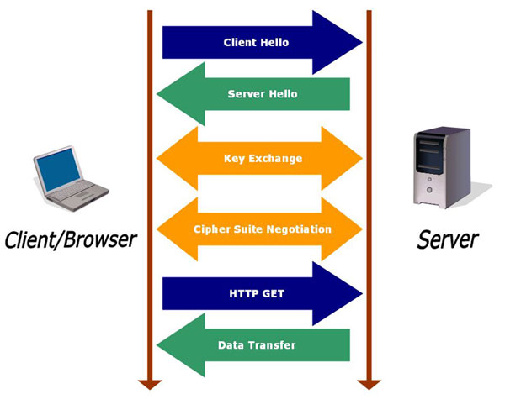
SSL

Slide 5
Kulcs generálás
"%JAVA_HOME%\bin\keytool" -genkey -alias tomcat -keyalg RSA -keystore \path\to\my\keystore

Slide 6
Tomcat server.xml
<Connector
port="8443" protocol="org.apache.coyote.http11.Http11NioProtocol"
maxThreads="150" SSLEnabled="true" scheme="https" secure="true"
keystoreFile="${catalina.home}/conf/ssl/.keystore" keystorePass="changeit"
clientAuth="false" sslProtocol="TLS" />

Slide 7
jaas.config
CustomRealm {
hu.neuron.java.login.CustomLoginModule required;
};

Slide 8
jaas config tomcat
<Realm className="org.apache.catalina.realm.JAASRealm"
appName="CustomRealm"
userClassNames="hu.neuron.java.login.UserPrincipal"
roleClassNames="hu.neuron.java.login.RolePrincipal" />
set JAVA_OPTS=%JAVA_OPTS% -Djava.security.auth.login.config=%CATALINA_HOME%\conf\jaas.config

